Slide 1

SCHOOL OF ELECTRICAL & ELECTRONICS ENGINEERING
SOLAR ENERGY HARVESTING
Guided by-
Dr. Nella Anveshkumar
(Assistant professor – SEEE)
Presented by-
Sakshi pathak (19BEE10004)
Sanjyot Sanjay khardekar (19BEE10021)
Deepshikha sen (19BEE10029)

Slide 2
CONTENT
INTRODUCTION
LITERATURE REVIEW
PROPOSED METHODOLOGY
BLOCK & CIRCUIT DIAGRAM
CONCLUSION
REFERENCE

Slide 3
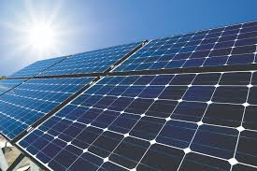
Introduction
A solar charger is a charger that employs solar energy to supply electricity to devices or batteries. They are generally portable.
Examples of solar chargers in popular use include: Small portable models designed to charge a range of different mobile phones, cell phones, iPods or other portable audio equipment.

Slide 4
Literature Review

Slide 5
Paper1:
A Review Paper on Electricity Generation from Solar Energy Mohd Rizwan Sirajuddin Shaikh 1, Santosh B. Waghmare 2, Suvarna Shankar Labade 3, Pooja Vittal Fuke4, Anil Tekale5 1, 2,3,4,5 Students, Department of Electrical Engineering, Savitribai Phule Pune University.
In this article, they have reviewed about the Solar Energy from Sunlight and discussed about their future trends and aspects. The article also tries to discussed working, solar panel types; emphasize the various applications and methods to promote the benefits of solar energy.
PV cells Convert Sunlight to Direct Current (DC) electricity with the help of inverter into Alternating Current (AC).
For website
https://www.researchgate.net/publication/320226399_A_Review_Paper_on_Electricity_Generation_from_Solar_Energy
Book
Shruti Sharma, Kamlesh Kumar Jain, Ashutosh Sharma a review on “Solar Cells: In Research and Applications", Materials Sciences and Applications, 2015, 6, 1145-1155 Published December 2015 http://dx.doi.org/10.4236/msa.2015.612113

Slide 6
Paper2:
Solar Cells: In Research and Applications—A Review Shruti Sharma1, Kamlesh Kumar Jain1, Ashutosh Sharma2, 1CMD College, Bilaspur, India 2Materials Science and Engineering, University of Seoul, Seoul, South Korea.
In this article, they have reviewed a progressive development in the solar cell research from one generation to other, and discussed about their future trends and aspects. The article also tries to emphasize the various practices and methods to promote the benefits of solar energy.
The working mechanism of solar cells is based on the three factors: (1) Adsorption of light in order to gener-ate the charge careers, holes (p-type) and electrons (n-type) (2) Separation of charge careers, and (3) the collection of charge careers at the respective electrodes establishing the potential difference across the p-n junction.
For website
https://www.researchgate.net/publication/288056432_Solar_Cells_In_Research_and_Applications-A_Review
Book
Choubey, P.C., Oudhia, A. and Dewangan, R. (2012) A Review: Solar Cell Current Scenario and Future Trends. Re-cent Research in Science and Technology, 4, 99-101.

Slide 7
Paper3:
Design and Analysis of a DC -DC Buck converter and Boost Converter to Achieve High Efficiency by altering duty cycle and input voltage R. Abhishek *, Pallavi Zoting*, Purva Ragit * Department of electronics and communication (ECE), VNIT-NAGPUR
This paper explains DC to DC buck convertor and boost converter which cites the dependency of duty cycle and input voltage on output voltage.
It consists of elements like switch/mosfet, transistor, inductor, resistors. A NGSpice simulation has been conducted to analyze the efficiency of the DC-DC buck converter and boost converter. The result shows the efficiency of the DC-DC buck and boost converter increases as we increase the duty cycle and the input voltage.
For website
https://www.researchgate.net/publication/342837349_Design_and_Analysis_of_a_DC_-DC_Buck_converter_and_Boost_Converter_to_Achieve_High_Efficiency_by_altering_duty_cycle_and_input_voltage
Book
Sairatun Nesa Soheli et al, Design and Analysis of a DC -DC Buck Boost Converter to Achieve High Efficiency and Low Voltage Gain by using Buck Boost Topology into Buck Topology, “IEEE Transactions on Power Electronics Year: 2018

Slide 8
PROBLEM IDENTIFICATION
Energy crisis is one of the important problems. To overcome this problem solar energy may be used as an alternative. It is not possible to solve the giant problem over a night but it can be decreased.
Everyday a lot of power is used for charging purpose like mobile, camera, light etc. Those devices can be easily charged by using solar charger.
Mobile and other smart devices keep on running all the time anywhere and everywhere, draining its battery. Sudden shutdown of mobile phones due to lack of charge, creates huge embargo for people who is in rush to workplace, market and so on. It would be great if we could facilitate these people with instant smart device charging opportunity through renewable energy harvesting, which they can avail whenever they need, on the go.

Slide 9
🔌
Objective
To develop a solar powered battery charger.
To develop a state of charge, (SOC) circuit to indicate the charging level of the batteries.

Slide 10
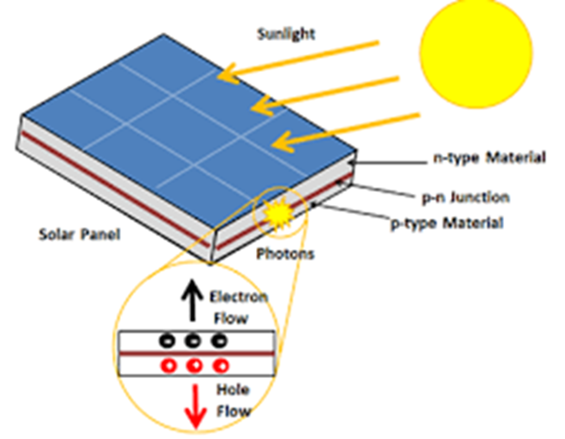
Proposed Methodology:
In this project we have used a solar panel that convert solar energy into electrical energy (DC) through photovoltaic effect. After that we use buck converter, it is used to convert high voltage into low voltage, so it produce variable dc voltage . Then we make connection between buck convertor and USB(Universal Serial Bus).

Slide 11
Hardware Components -
Solar panel
Buck Convertor
USB (universal serial bus)
MATLAB
Software -

Slide 12
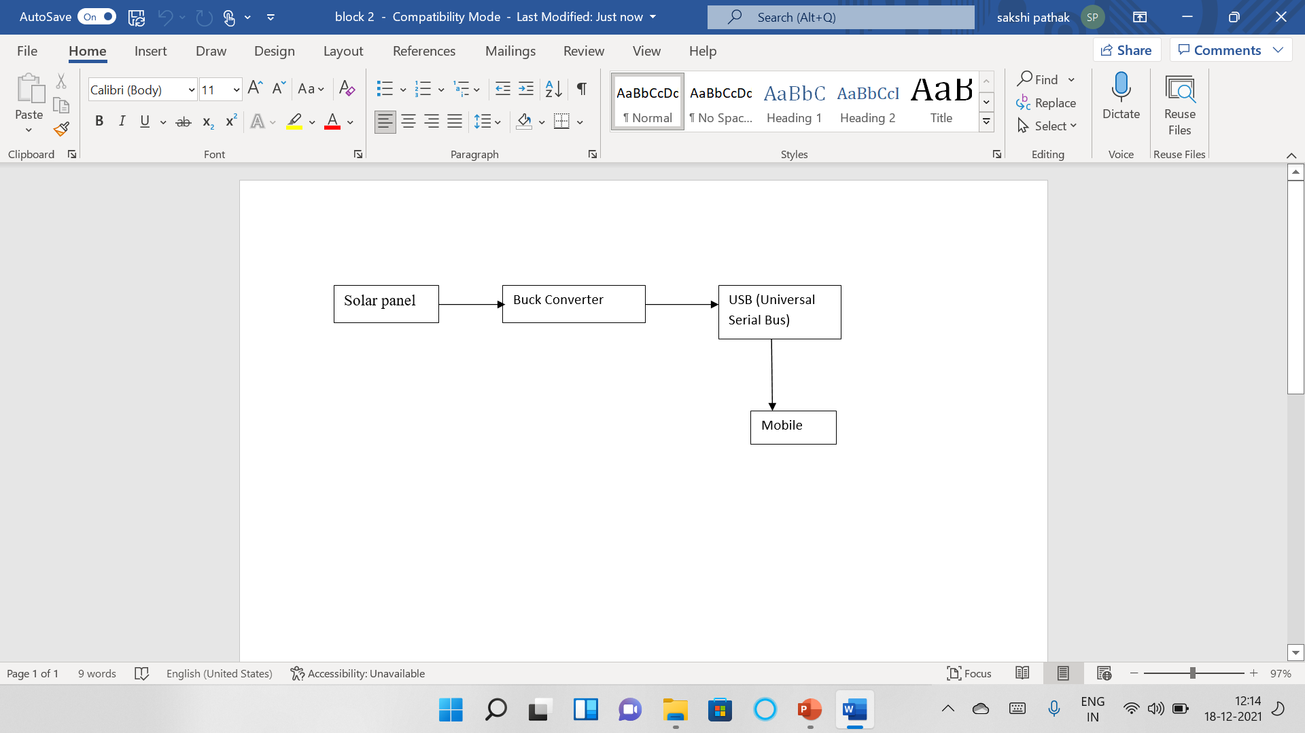
Block Diagram

Slide 13
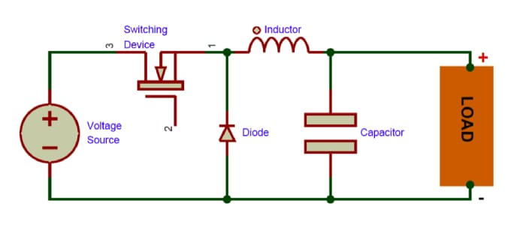
Buck Converter
A buck converter (step-down converter) is a DC-to-DC power converter which steps down voltage from its input (supply) to its output (load).

Slide 14
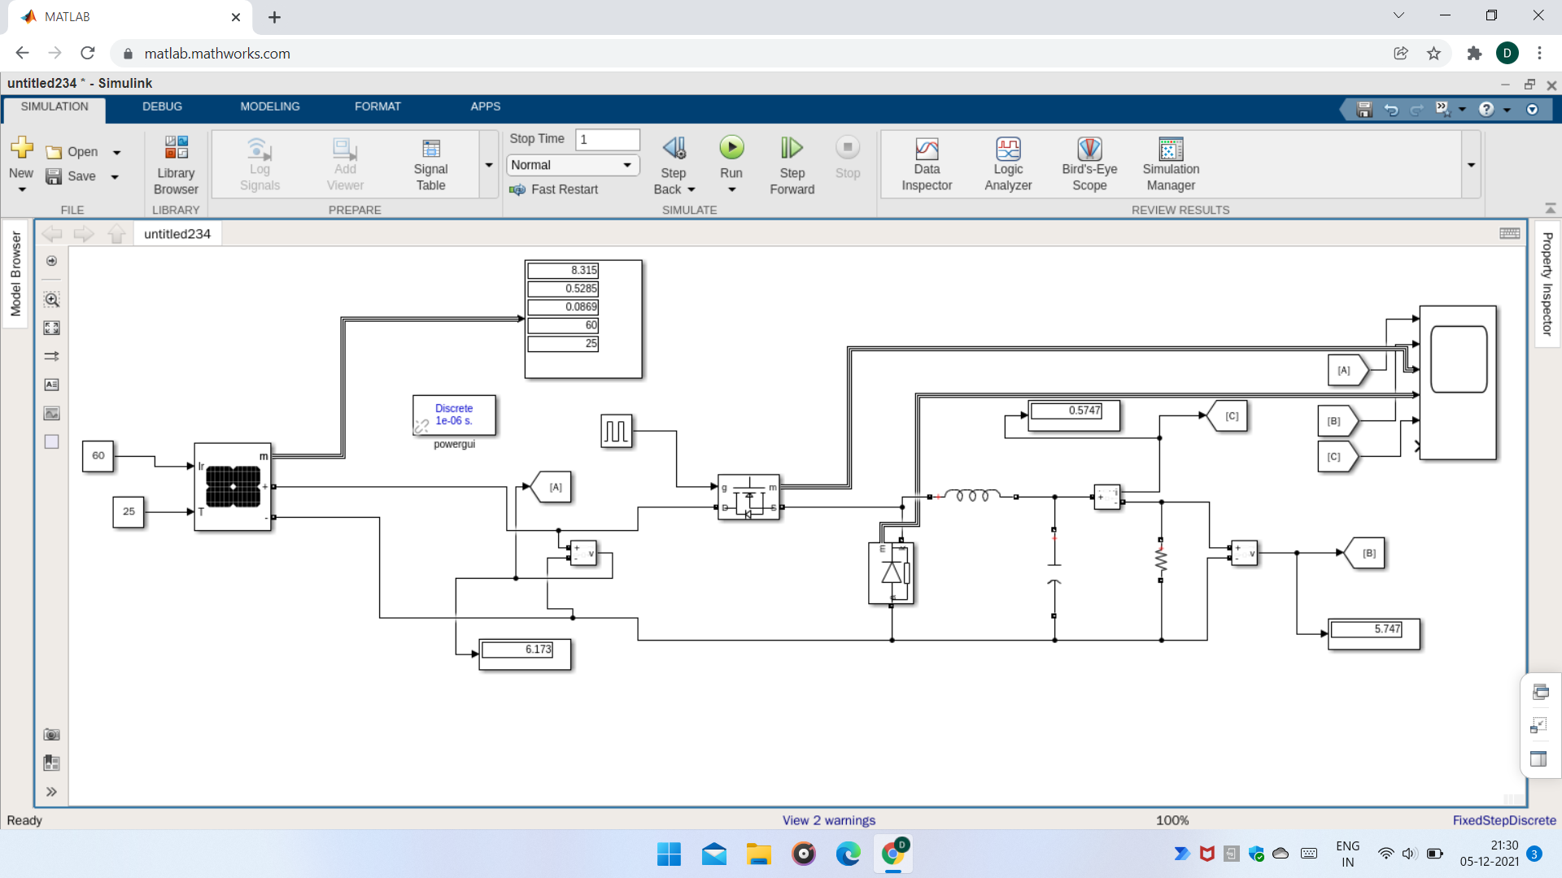
Circuit Diagram

Slide 15
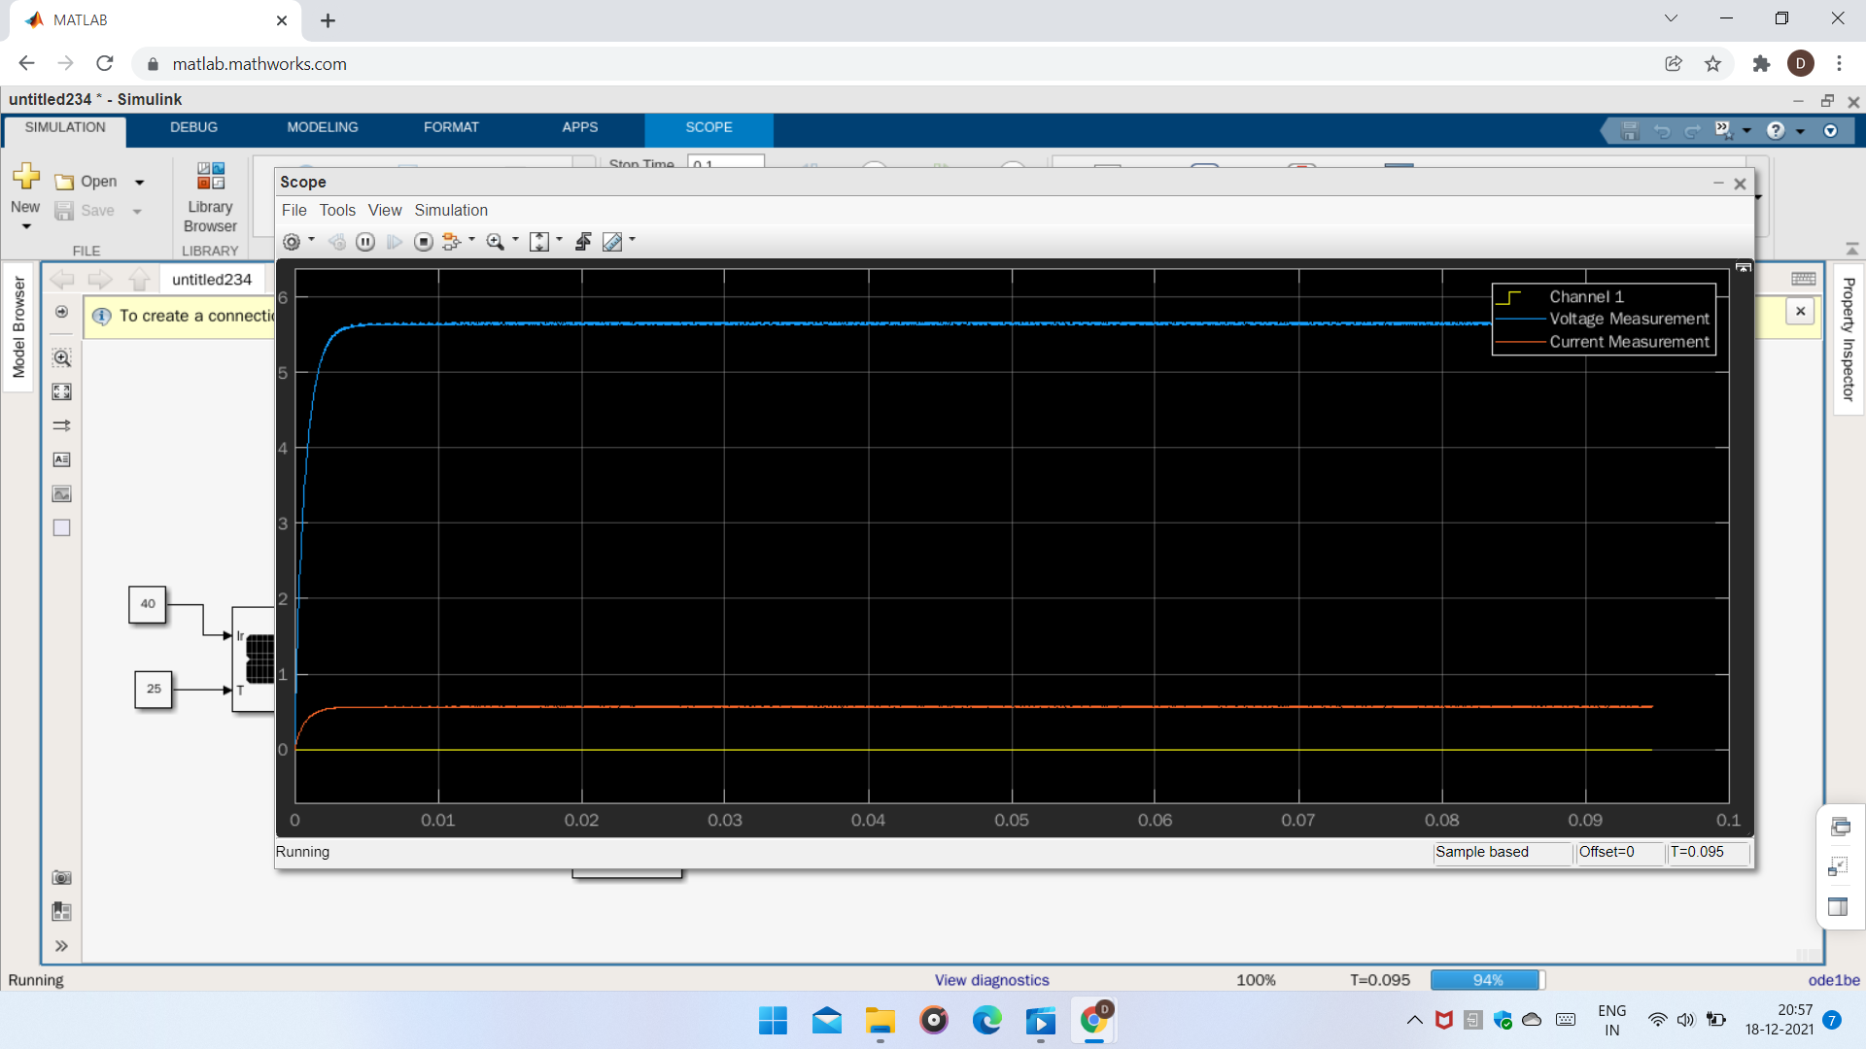
Graph

Slide 16
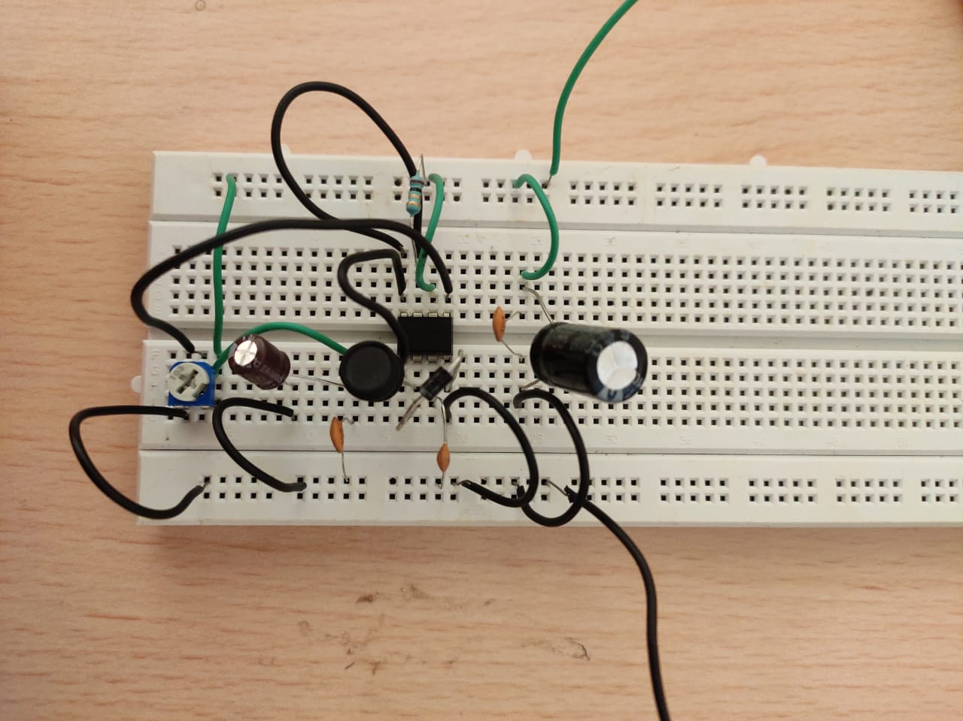

Slide 17
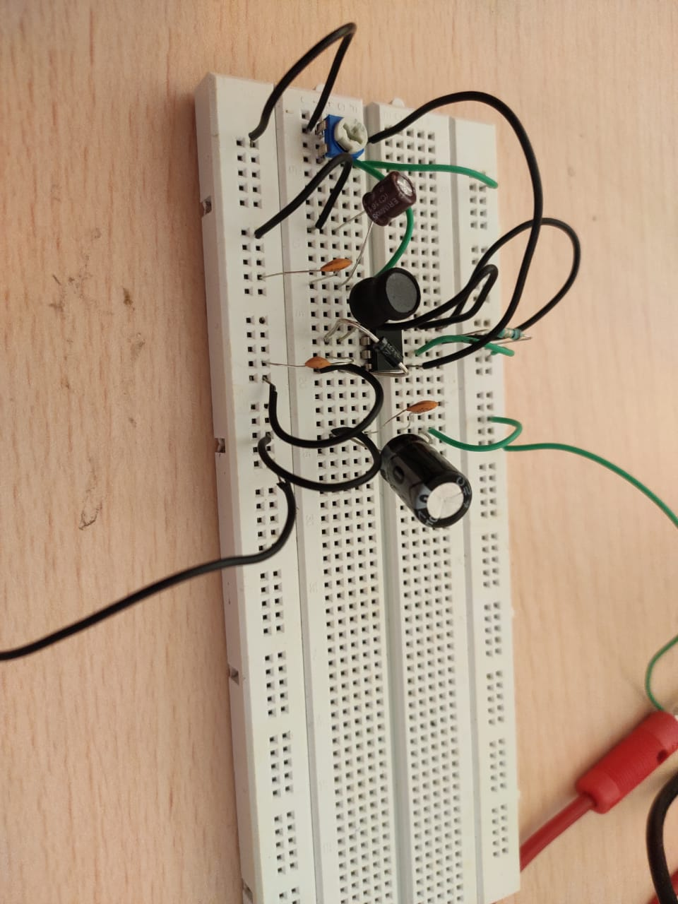
Components:
1x MC34063 IC
1x 1N5819 DIODE
1x 330uH INDUCTOR
1x 1nF CAPACITOR
2x 100nF CAPACITOR
1x 100uF CAPACITOR
1x 1000uF CAPACITOR
1x 10KVARIABLE RESISTOR
1x 1 OHM RESISTOR
BREADBOARD
JUMPER WIRES

Slide 18
Limitation
Quite expensive: compared to the ordinary mobile phone chargers, it is quite expensive as it utilizes solar energy captivators.
More Charging time : the chargers to charge mobile phones. It can take six to eight hours to charge mobile phones compared to the other.

Slide 19
Advantage
Versatile: it can be used for all types of mobile phones
Uninterrupted Power Supply
Cost Effective: it absorbs power from the sun. It does not require electric power.
There are many homes where solar power charger are being used in the event of a power failure. Their presence will ensure that all tasks in the home will continue without any hassle despite a power failure.

Slide 20
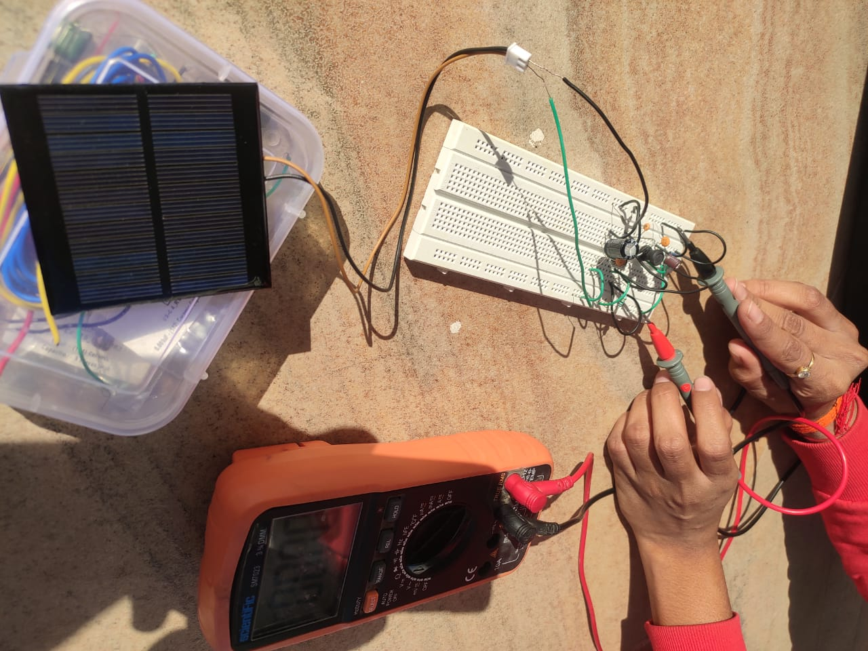

Slide 21
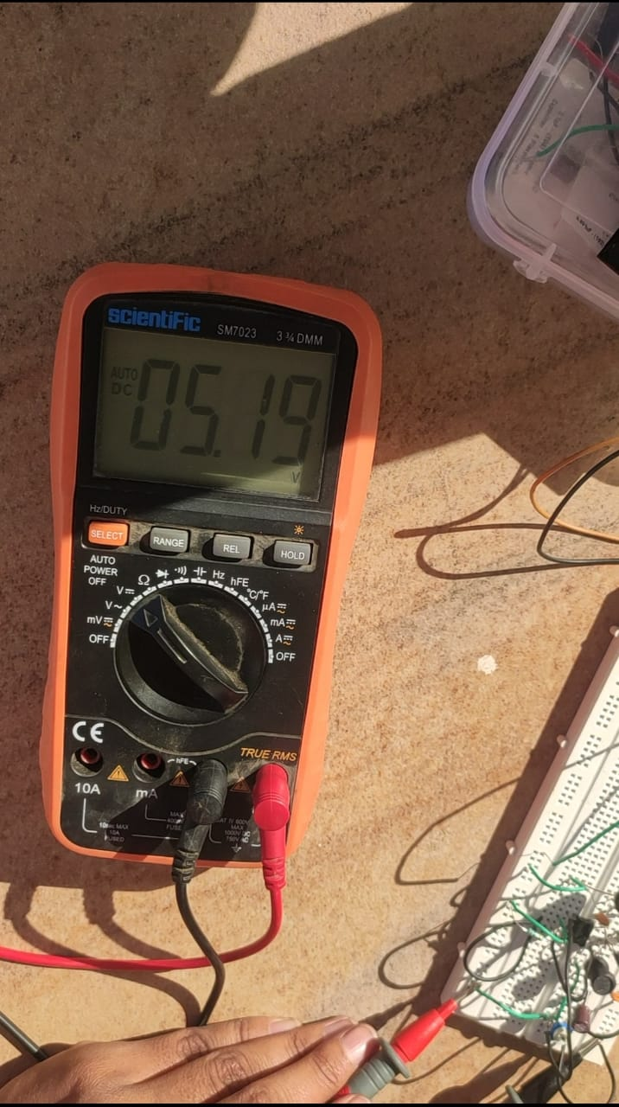
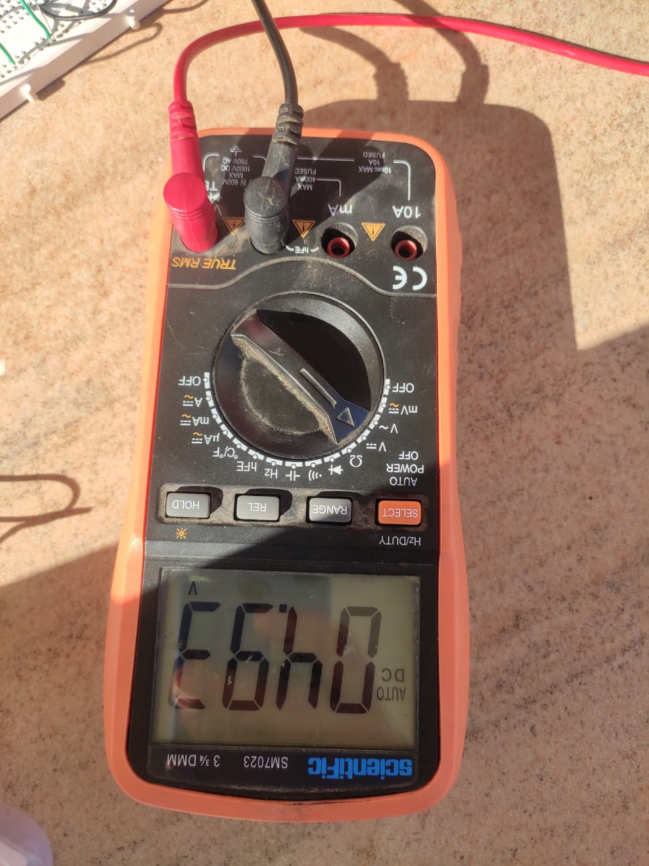
Output Voltage

Slide 22
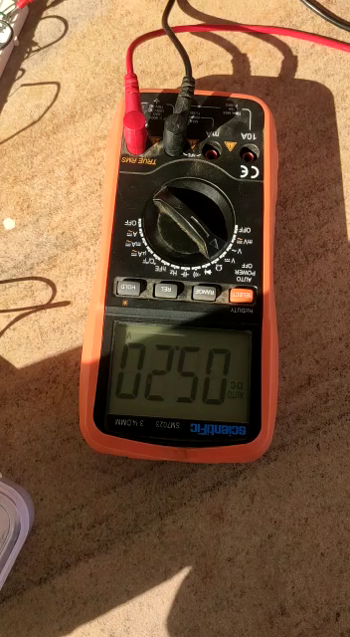

Slide 23
Conclusion
As solar powered energy becomes increasingly popular, these phone chargers will rise in popularity as well. Because people are searching for new and improved forms of energy, solar energy is becoming a very appreciated idea. Fossil fuels and non-renewable energy sources are ways of the past. This is the way of the future. Solar powered phone chargers will soon be everywhere.
Solar powered cell phone chargers can be a better alternative to electrical cell phone chargers.
Solar act as good power supplies in bright sunlight. The only problem is the unregulated voltage due to the variation in intensity of light. Voltage regulator is used to solve this problem by regulating the output voltage.

Slide 24
Work Plan
👉
1 | Literature survey with detail | 27/09/2021
2 | Planning | 15/10/2021
3 | Design | 30/10/2021
4 | Implementation | 20/11/2021
5 | validation | 30/11/2021

Slide 25
Reference
1. Askari Mohammad Bagher, Mirzaei Mahmoud Abadi Vahid, Mirhabibi Mohsen. “Types of Solar Cells and Application”. American Journal of Optics and Photonics.Vol. 3, No. 5, 2015, pp. 94-113. doi: 10.11648/j.ajop.20150305.17
2. N. Gupta, G. F. Alapatt, R. Podila, R. Singh, K.F. Poole, (2009). "Prospects of Nanostructure-Based Solar Cells for Manufacturing Future Generations of Photovoltaic Modules". International Journal of Photo energy 2009: 1. doi:10.1155/2009/154059.
3. Solar Electricity Engineering of Photovoltaic System, by Lorezo E
4. Yadav, A. and Kumar, P. (2015) Enhancement in Efficiency of PV Cell through P&O Algorithm. International Jour-nal for Technological Research in Engineering, 2, 2642-2644.
5. Chu, Y. and Meisen, P. (2011) Review and Comparison of Different Solar Energy Technologies. Report of Global S. Sharma et al. 1153 Energy Network Institute (GENI), Diego.
6.

Slide 26
THANKS!
📖

